Slide 1
GEOG0113 Lecture 002 Carbon and Climate
H. Heorton
UCL Geography
& NERC NCEO

Slide 2
Aims of lecture
In this lecture, we will:
consider the importance of understanding the science of climate change
look at basic principles of energy transfer in the earth system
examine greenhouse gases and their sources

Slide 3
Terrestrial Climate and Climate Change
“(C)limate change is a defining issue of our generation. Our responses to the challenges of climate change - accurate prediction, equitable adaptation, and efficient mitigation - will influence the quality of life for ... the world, for generations to come.” (NASA, 2010).

Slide 4
AR6 (Sept 2022)
AR5 (2014): AR6 2021-22
https://www.ipcc.ch/report/ar6/wg1/
It is unequivocal that human influence has warmed the atmosphere, ocean and land.
Observed increases in well-mixed greenhouse gas (GHG) concentrations since around 1750 are unequivocally caused by human activities.
Read https://www.ipcc.ch/report/sixth-assessment-report-working-group-i/
Explore https://interactive-atlas.ipcc.ch/
Notes:
Verbatim from https://www.ipcc.ch/report/ar6/wg1/downloads/report/IPCC_AR6_WGI_SPM_final.pdf
It is unequivocal that human influence has warmed the atmosphere, ocean and land.
Widespread and rapid changes in the atmosphere, ocean, cryosphere and biosphere have occurred
Observed increases in well-mixed greenhouse gas (GHG) concentrations since around 1750 are unequivocally caused by human activities.
Since 2011 (measurements reported in AR5), concentrations have continued to increase in the atmosphere, reaching annual averages of 410 parts per million (ppm) for carbon dioxide (CO2), 1866 parts per billion (ppb) for methane (CH4), and 332 ppb for nitrous oxide (N2O) in 2019.6 Land and ocean have taken up a near-constant proportion (globally about 56% per year) of CO2 emissions from human activities over the past six decades, with regional differences (high confidence).

Slide 5
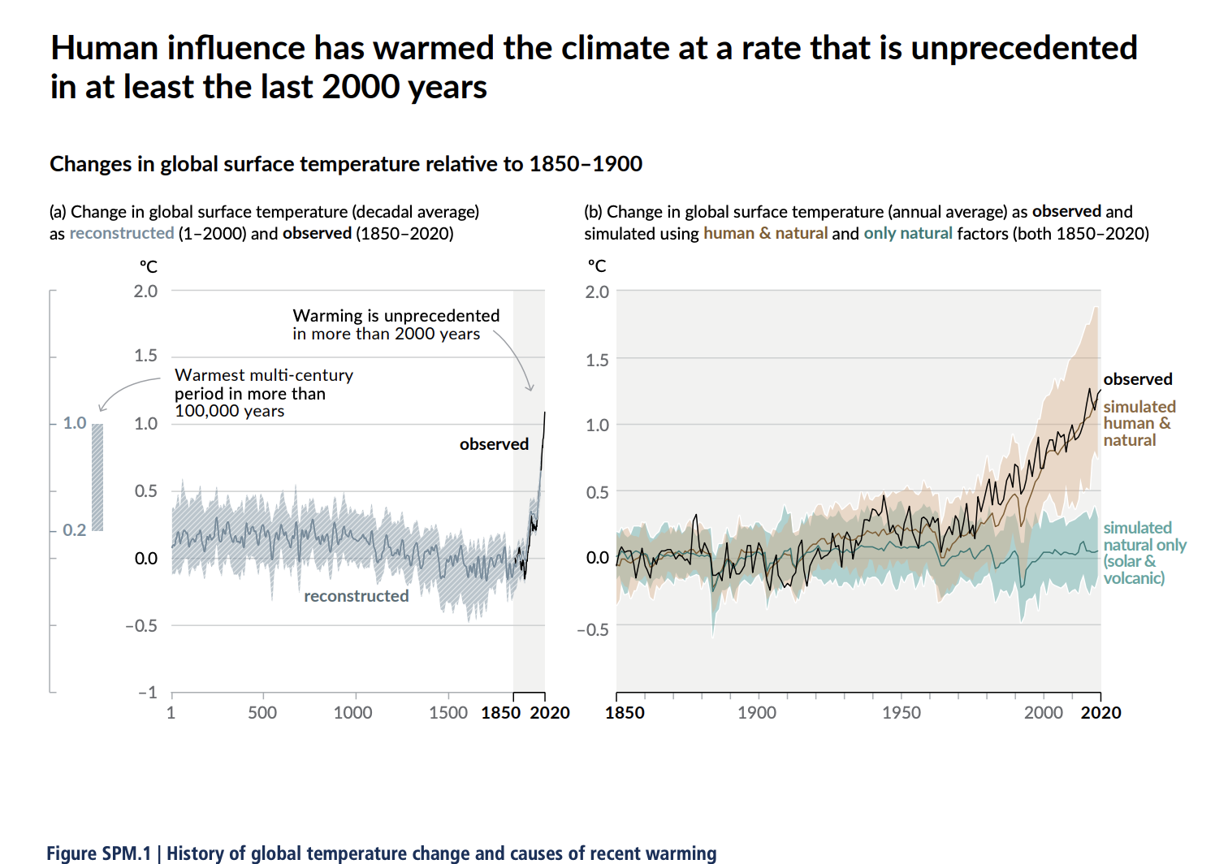
From the IPCC AR6 (synthesis report) Observed changes and their causes
https://www.ipcc.ch/report/ar6/wg1/downloads/report/IPCC_AR6_WGI_SPM_final.pdf
The scale of recent changes across the climate system as a whole and the present state of many aspects of the climate system are unprecedented over many centuries to many thousands of years.
Notes:
The best estimate of the human-induced contribution to warming is similar to the observed warming over this period (Figure SPM.3). Figure SPM.3 | Assessed likely ranges (whiskers) and their mid-points (bars) for warming trends over the 1951–2010 period from well-mixed greenhouse gases, other anthropogenic forcings (including the cooling effect of aerosols and the effect of land use change), combined anthropogenic forcings, natural forcings and natural internal climate variability (which is the element of climate variability that arises spontaneously within the climate system even in the absence of forcings). The observed surface temperature change is shown in black, with the 5 to 95% uncertainty range due to observational uncertainty. The attributed warming ranges (colours) are based on observations combined with climate model simulations, in order to estimate the contribution of an individual external forcing to the observed warming. The contribution from the combined anthropogenic forcings can be estimated with less uncertainty than the contributions from greenhouse gases and from other anthropogenic forcings separately. This is because these two contributions partially compen- sate, resulting in a combined signal that is better constrained by observations. {Figure 1.9}

Slide 6
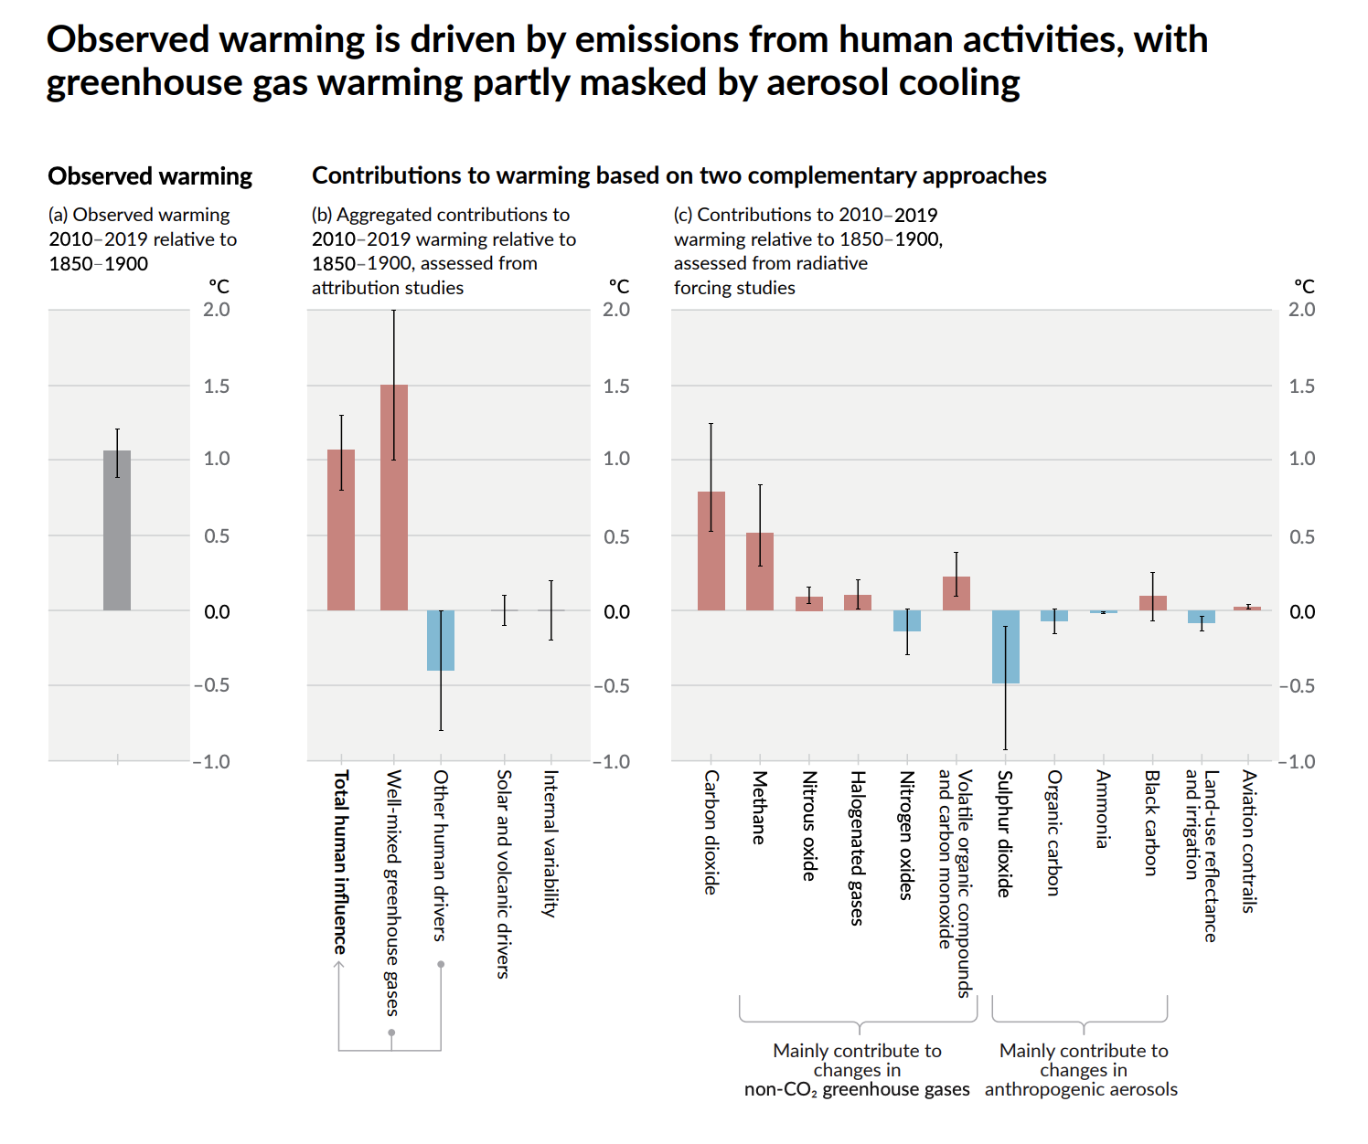
Observed warming is driven by emissions from human activities
https://www.ipcc.ch/report/ar6/wg1/downloads/report/IPCC_AR6_WGI_SPM_final.pdf
Notes:
Panel a): Observed global warming (increase in global surface temperature) and its very likely range {3.3.1,
Cross-Chapter Box 2.3}.
Panel b): Evidence from attribution studies, which synthesize information from climate models and observations. The panel shows temperature change attributed to total human influence, changes in well-mixed greenhouse gas concentrations, other human drivers due to aerosols, ozone and land-use change (land-use reflectance), solar and volcanic drivers, and internal climate variability. Whiskers show likely ranges {3.3.1}.
Panel c): Evidence from the assessment of radiative forcing and climate sensitivity. The panel shows temperature changes from individual components of human influence, including emissions of greenhouse gases, aerosols and their precursors; land-use changes (land-use reflectance and irrigation); and aviation contrails. Whiskers show very likely ranges. Estimates account for both direct emissions into the atmosphere and their effect, if any, on other climate drivers. For aerosols, both direct (through radiation) and indirect (through interactions with clouds) effects are considered.{6.4.2, 7.3}

Slide 7
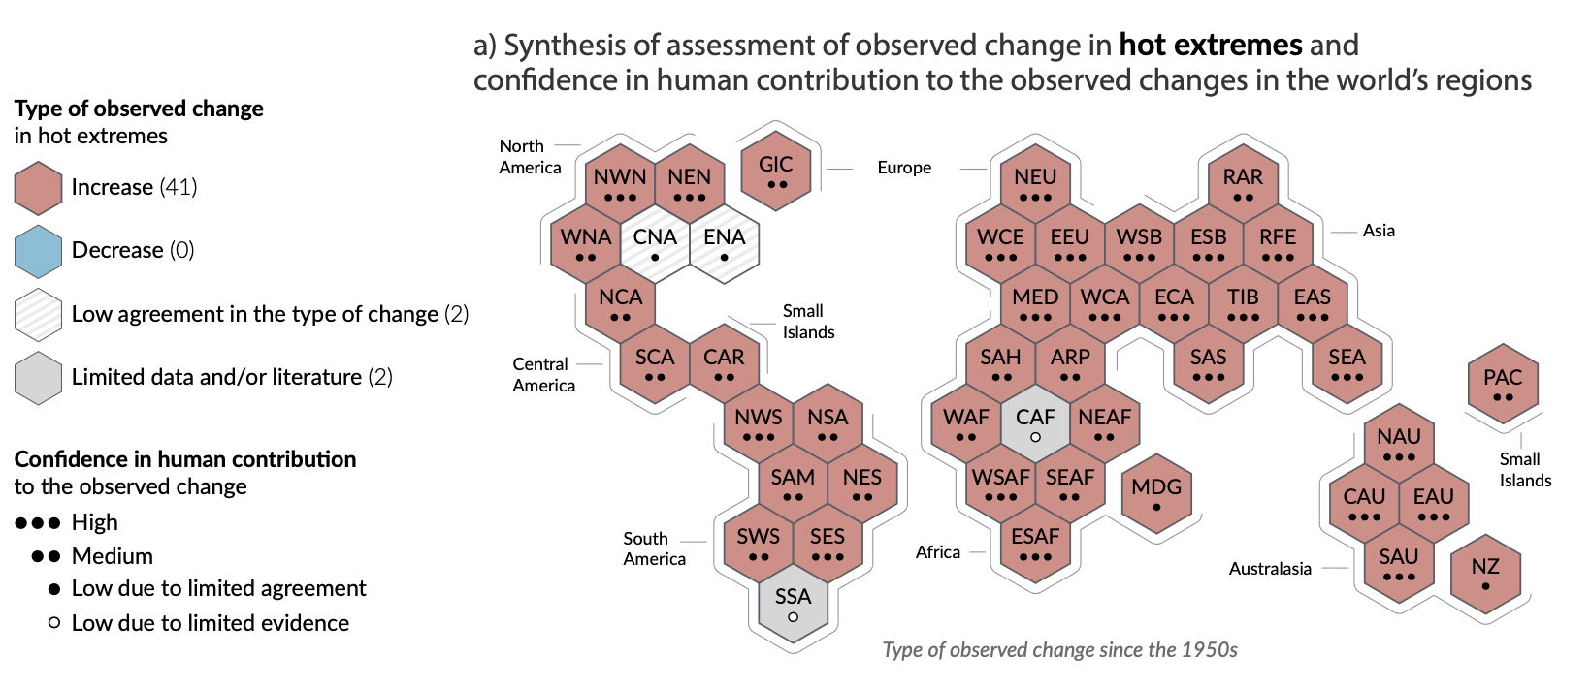
Climate change is already affecting every inhabited region across the globe with human influence contributing to many observed changes in weather and climate extremes
Notes:
The scale of recent changes across the climate system as a whole and the present state of many aspects of the climate system are unprecedented over many centuries to many thousands of years.

Slide 8
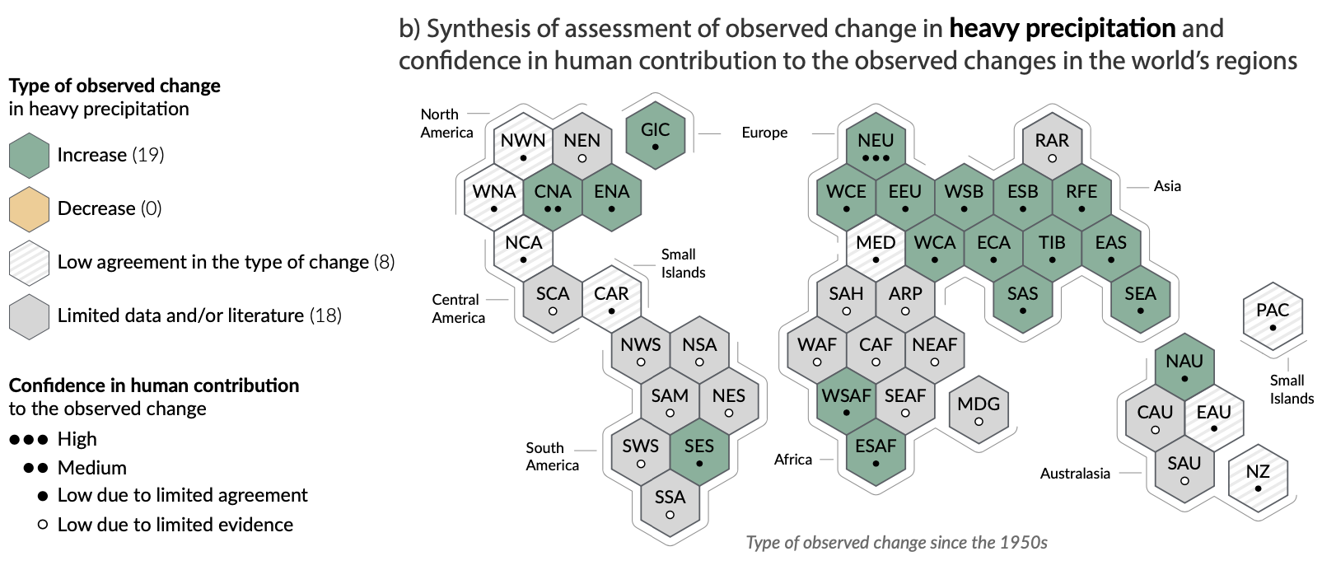
Climate change is already affecting every inhabited region across the globe with human influence contributing to many observed changes in weather and climate extremes
Notes:
The scale of recent changes across the climate system as a whole and the present state of many aspects of the climate system are unprecedented over many centuries to many thousands of years.

Slide 9
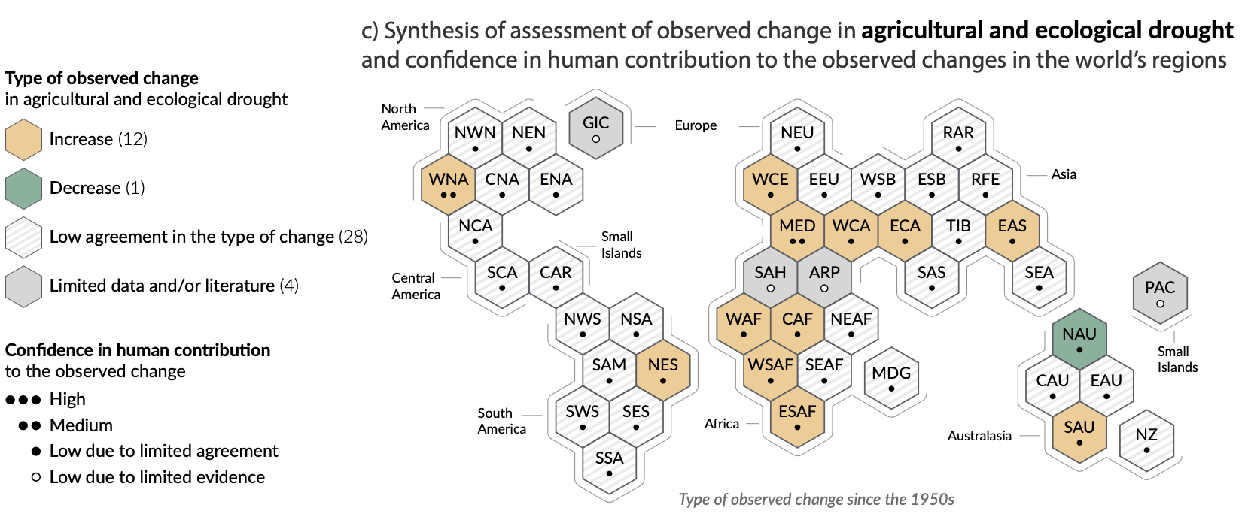
Climate change is already affecting every inhabited region across the globe with human influence contributing to many observed changes in weather and climate extremes
Notes:
The scale of recent changes across the climate system as a whole and the present state of many aspects of the climate system are unprecedented over many centuries to many thousands of years.

Slide 10
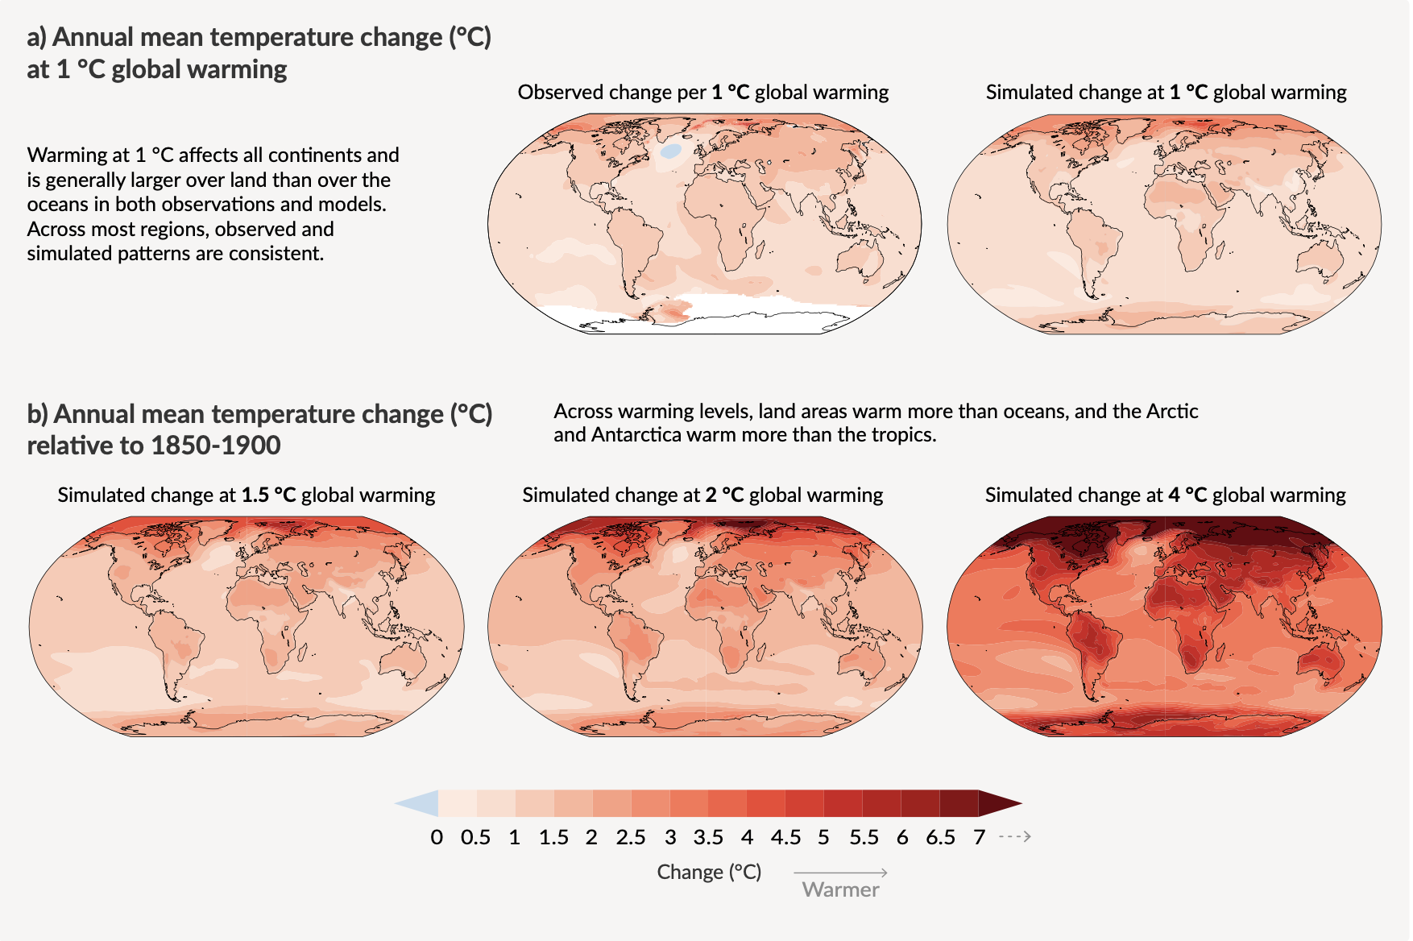
Future Climate Changes, Risks and Impacts With every increment of global warming, changes get larger in regional mean temperature, precipitation and soil moisture
Notes:
Changes in annual mean surface temperature, precipitation, and soil moisture.

Slide 11
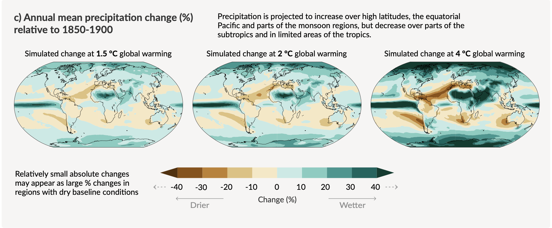
Future Climate Changes, Risks and Impacts With every increment of global warming, changes get larger in regional mean temperature, precipitation and soil moisture

Slide 12
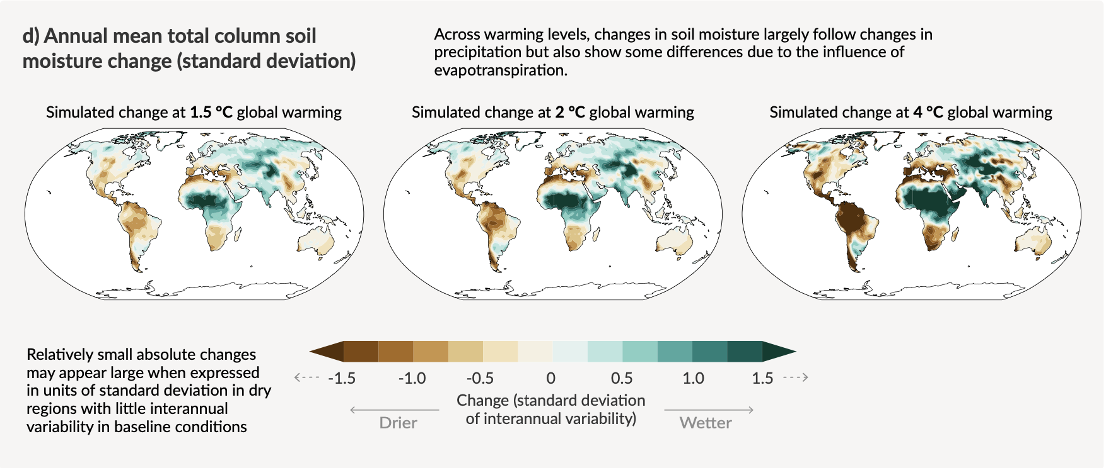
Future Climate Changes, Risks and Impacts With every increment of global warming, changes get larger in regional mean temperature, precipitation and soil moisture

Slide 13
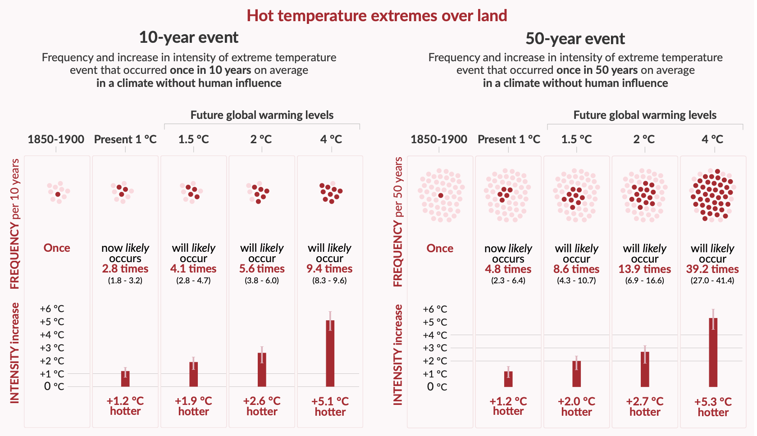
Projected changes in extremes are larger in frequency and intensity with every additional increment of global warming
Notes:
Projected changes in the intensity and frequency of hot temperature extremes over land, extreme precipitation over land, and agricultural and ecological droughts in drying regions.

Slide 14
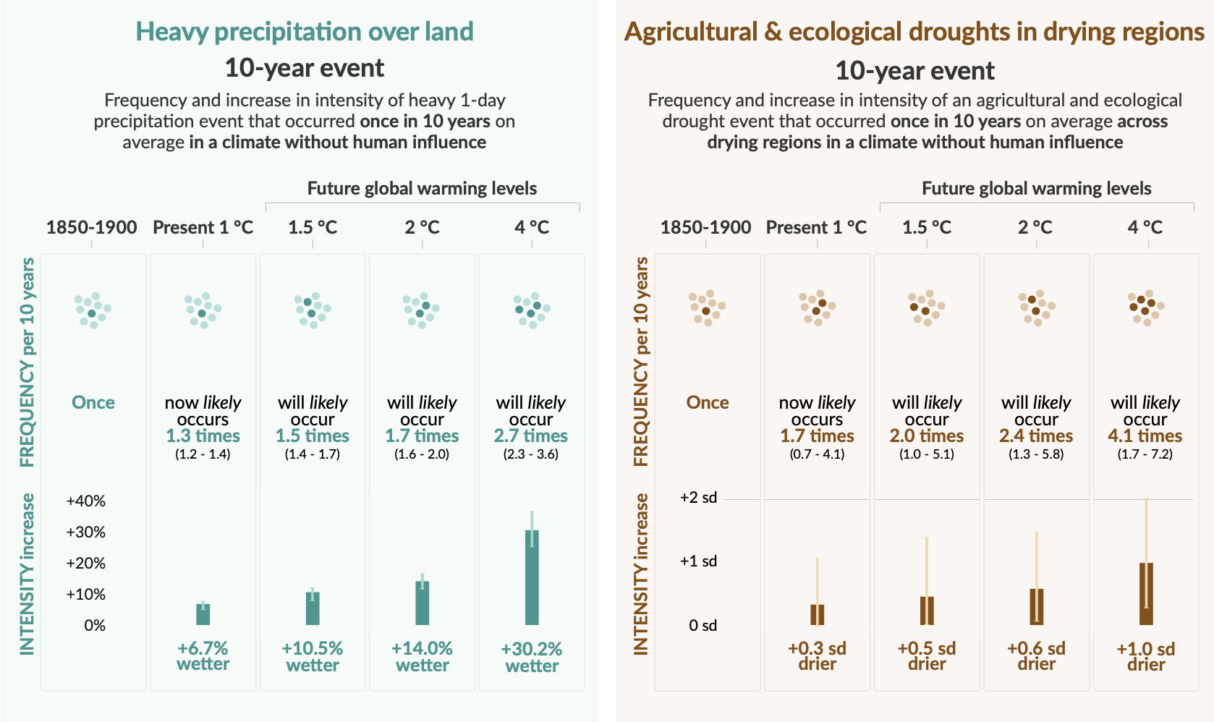
Projected changes in extremes are larger in frequency and intensity with every additional increment of global warming
Notes:
Projected changes in the intensity and frequency of hot temperature extremes over land, extreme precipitation over land, and agricultural and ecological droughts in drying regions.

Slide 15
How to measure impacts?
accumulation of energy in the Earth system
Effective Radiative Forcing (ERF)
robust measure of climate change on interannual-to-decadal time scales
Better indication of climate change than just global surface T

Slide 16
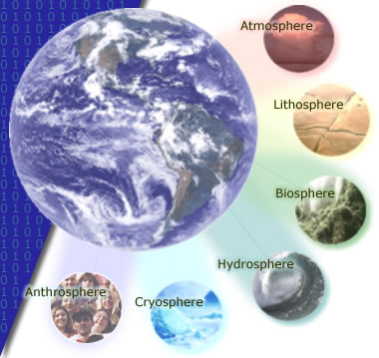
The 'spheres' of influence on the climate system

Slide 17

Energy transfer: basics
Driven by solar radiation

Slide 18
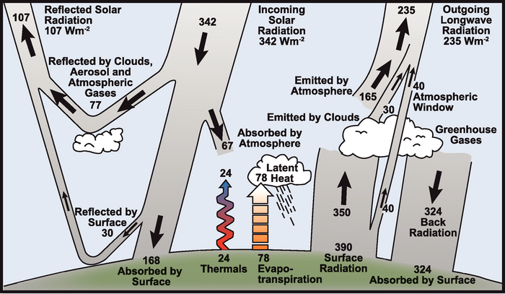
Earth’s climate is driven by (shortwave) solar radiation
Notes:
Around 31% of this incoming radiation is reflected by clouds, aerosols and gases in the atmosphere and by the land surface. The remaining 69% is absorbed, with almost 50% of the incoming radiation being absorbed at the Earth surface.
The shortwave radiation absorbed at the surface is, in the long term, transferred back to the atmosphere, so that around 69% of the incoming energy flux is re-rediated to space as longwave radiation.
The energy absorbed at the surface drives thermals (atmospheric convection) and evapo-transpiration (latent heat transfer: change of state of water). The rest of the energy balance is maintained by thermal (longwave) radiation emitted by the surface, the atmosphere and clouds.

Slide 19
large proportion of longwave radiation emitted by the surface is re-radiated back to the surface (and absorbed by the surface) by clouds and so-called greenhouse gases
‘trapping’ of longwave radiation naturally maintains temperature on Earth – the ‘natural greenhouse effect’.
Without this, temperature much less that it presently is (-19C)

Slide 20
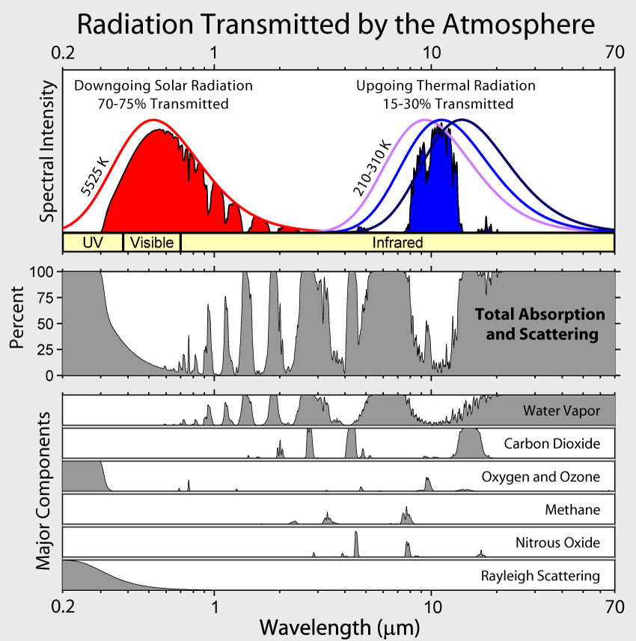
Atmospheric absorption
Notes:
major absorbing (and scattering, other than aerosols) constituents of the atmosphere for shortwave and longwave wavelengths and their impact on atmospheric transmission. … discuss + mention clouds & aerosols

Slide 21
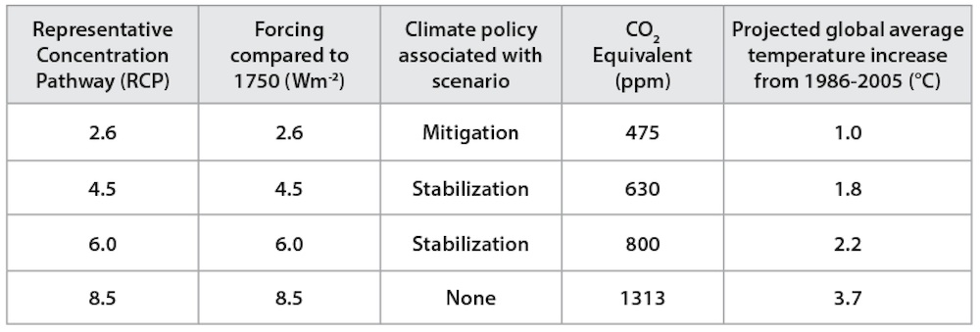
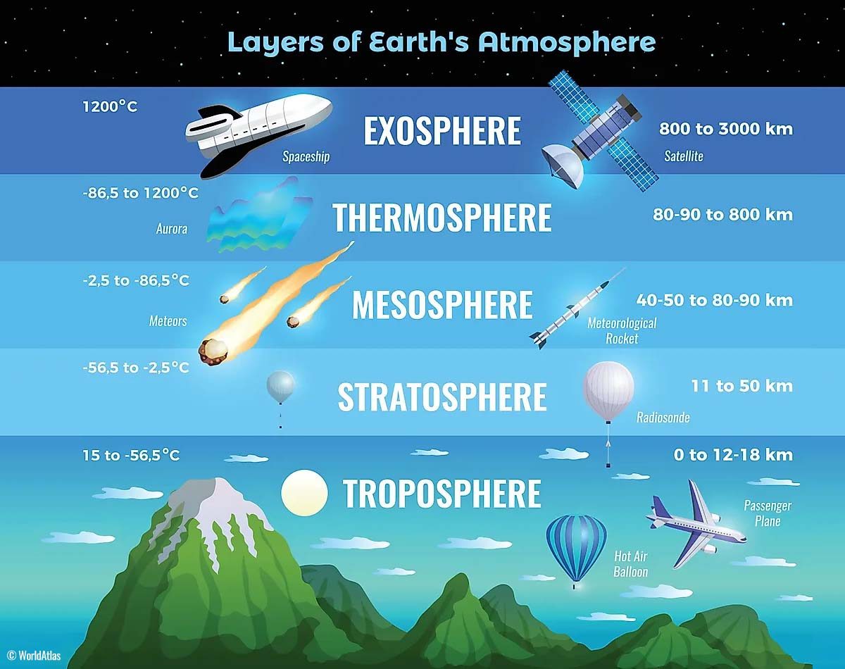
Radiative Forcing
Measure of the radiative impact (heating effect) at tropopause of components of the climate system
Change in energy relative to 1750, W/m² available to the climate system caused by a change in one or more components of the Earth's radiative budget
influence a factor has in altering the balance of incoming and outgoing energy in the Earth-atmosphere system and is an index of the importance of the factor as a potential climate change mechanism.
Attribute impacts of factors on climate warming (+ve)
http://www.climate.gov/media/9604
Read: https://www.nap.edu/download/11175
Notes:
Weather: https://learnweather.com/basic-weather/atmosphere-where-do-thunderstorms-live-mk/

Slide 22
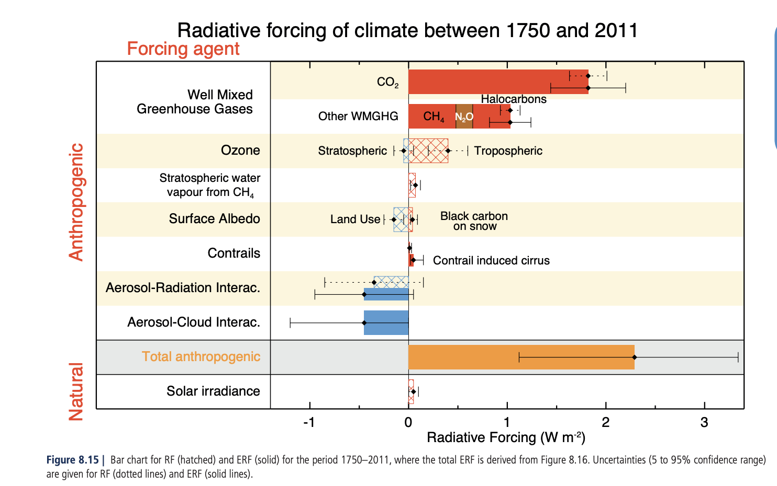
(E) Radiative Forcing
Effective Radiative Forcing (ERF), the “change in net TOA downward radiative flux after allowing for atmospheric temperatures, water vapour and clouds to adjust, but with surface temperature or a portion of surface conditions unchanged” (WG1AR5 Chapter08, Box 8.1).
Used AR5+ instead of instantaneous RF

Slide 23
Rockstrom et al. (2009)
“human changes to atmospheric CO2 concentrations should not exceed 350 parts per million by volume, and that radiative forcing should not exceed 1 watt per square metre above pre-industrial levels. Transgressing these boundaries will increase the risk of irreversible climate change, such as the loss of major ice sheets, accelerated sea- level rise and abrupt shifts in forest and agricultural systems. Current CO2 concentration stands at 387 p.p.m.v. and the change in radiative forcing is 1.5 W m^-2”
What about more recently? Paris agreement Dec 2015:
The Paris Agreement’s central aim was to strengthen the global response to the threat of climate change by keeping a global temperature rise this century well below 2 degrees Celsius above pre-industrial levels and to pursue efforts to limit the temperature increase even further to 1.5 degrees Celsius.
https://unfccc.int/process-and-meetings/the-paris-agreement/the-paris-agreement
Is this likely/on track?

Slide 24
Carbon in the Earth System
4th most abundant element in the universe.
able to bond with itself and many other elements
forms over 10 million known compounds.
present
in the atmosphere as CO2, CH4 etc
in all natural waters as dissolved CO2
in various carbonates in rocks
as organic molecules in living and dead organisms in the biosphere .

Slide 25
Carbon in the Earth System
also important in radiative forcing
Directly
Halocarbons in the atmosphere
black carbon deposits on snow
indirectly
elsewhere (e.g. land cover change).
See Friedlingstein et al 2022 Global Carbon Budget 2022 for the most up-to-date figures including key details of HOW different components are estimated

Slide 26
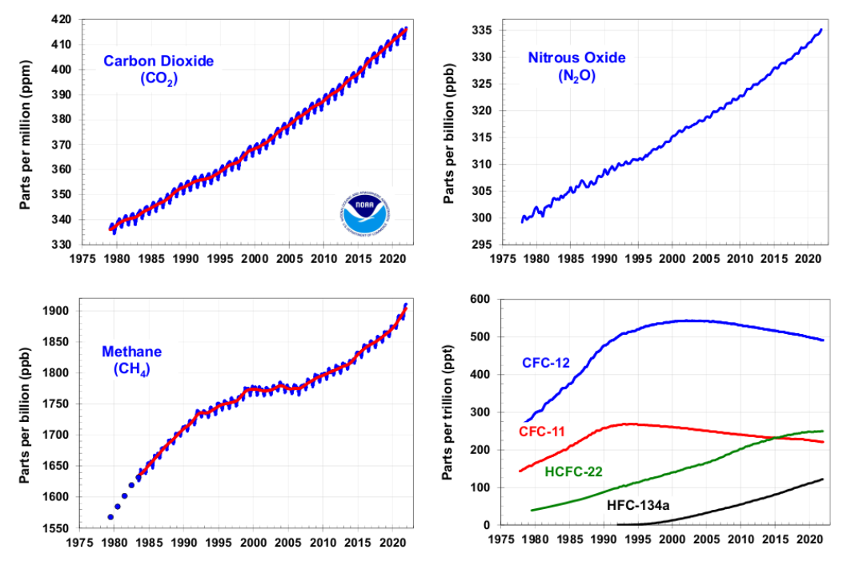
Atmospheric Carbon and Greenhouse Gases
Notes:
Global average abundances of the major, well-mixed, long-lived greenhouse gases - carbon dioxide, methane, nitrous oxide, CFC-12 and CFC-11 - from the NOAA global air sampling network are plotted since the beginning of 1979. These gases account for about 96% of the direct radiative forcing by long-lived greenhouse gases since 1750. The remaining 4% is contributed by an assortment of 15 minor halogenated gases (see text). Methane data before 1983 are annual averages from Etheridge et al. (1998), adjusted to the NOAA calibration scale [Dlugokencky et al., 2005].

Slide 27
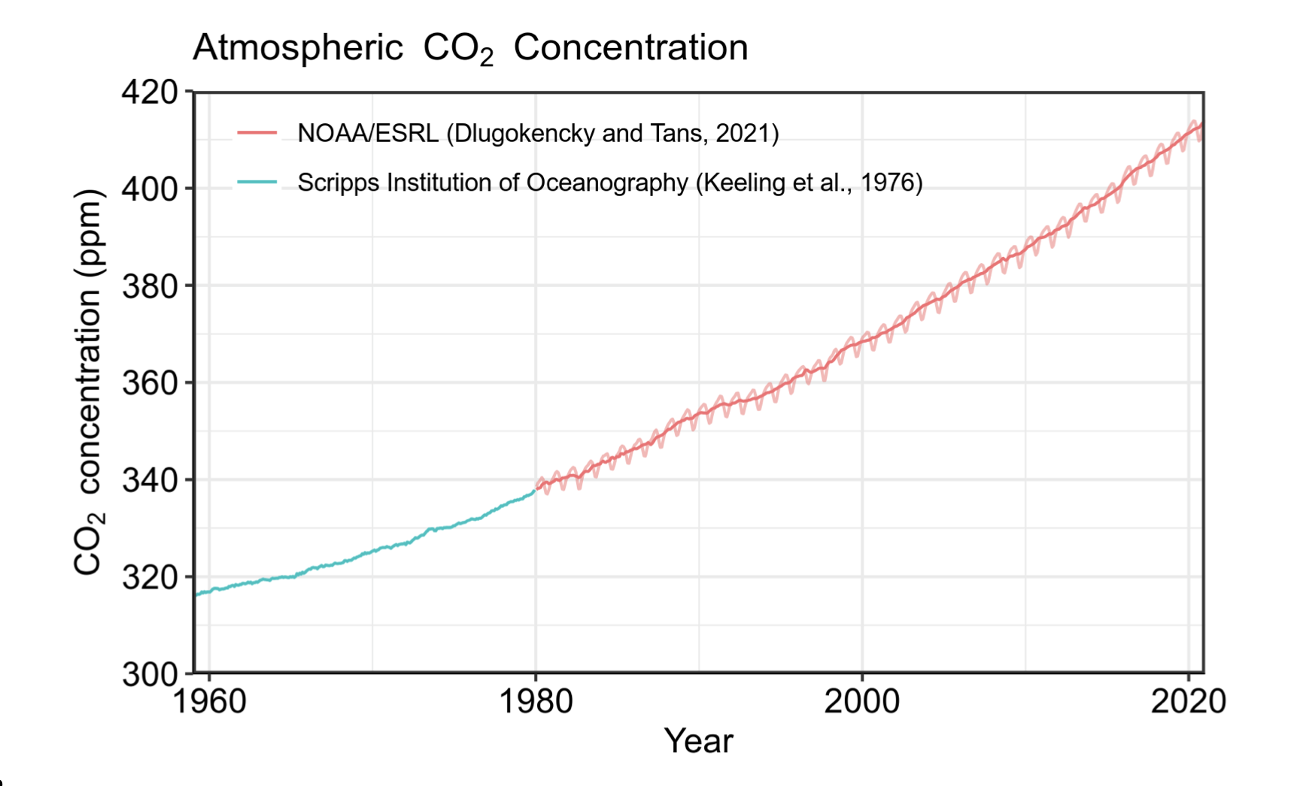
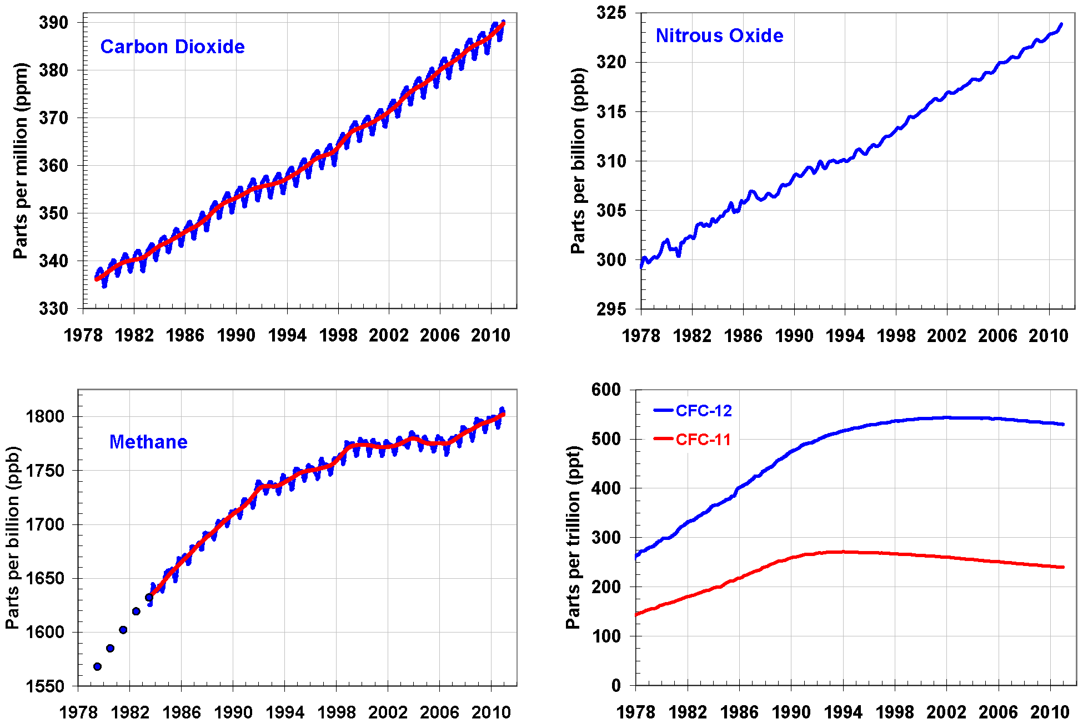
Atmospheric Carbon and Greenhouse Gases
Notes:
Global average abundances of the major, well-mixed, long-lived greenhouse gases - carbon dioxide, methane, nitrous oxide, CFC-12 and CFC-11 - from the NOAA global air sampling network are plotted since the beginning of 1979. These gases account for about 96% of the direct radiative forcing by long-lived greenhouse gases since 1750. The remaining 4% is contributed by an assortment of 15 minor halogenated gases (see text). Methane data before 1983 are annual averages from Etheridge et al. (1998), adjusted to the NOAA calibration scale [Dlugokencky et al., 2005].
Large CO2 plot: https://essd.copernicus.org/preprints/essd-2021-386/essd-2021-386.pdf

Slide 28
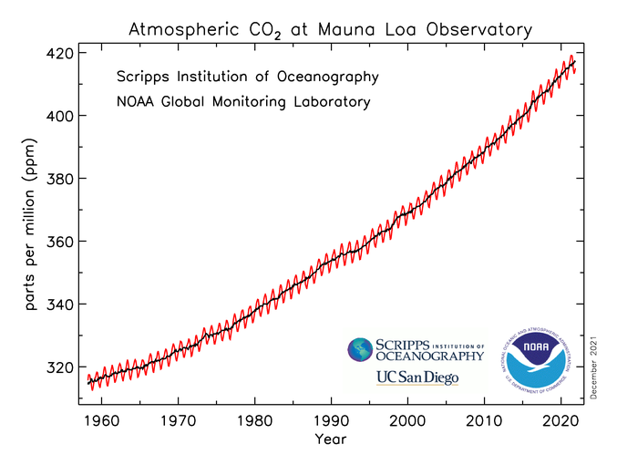
Annual cycles
https://www.esrl.noaa.gov/gmd/ccgg/trends/

Slide 29
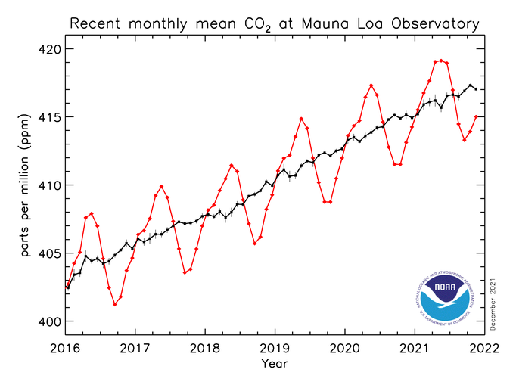

Annual cycles
https://www.esrl.noaa.gov/gmd/ccgg/trends/

Slide 30
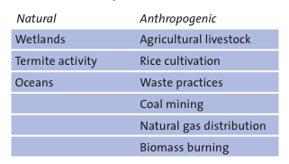
Methane

Slide 31
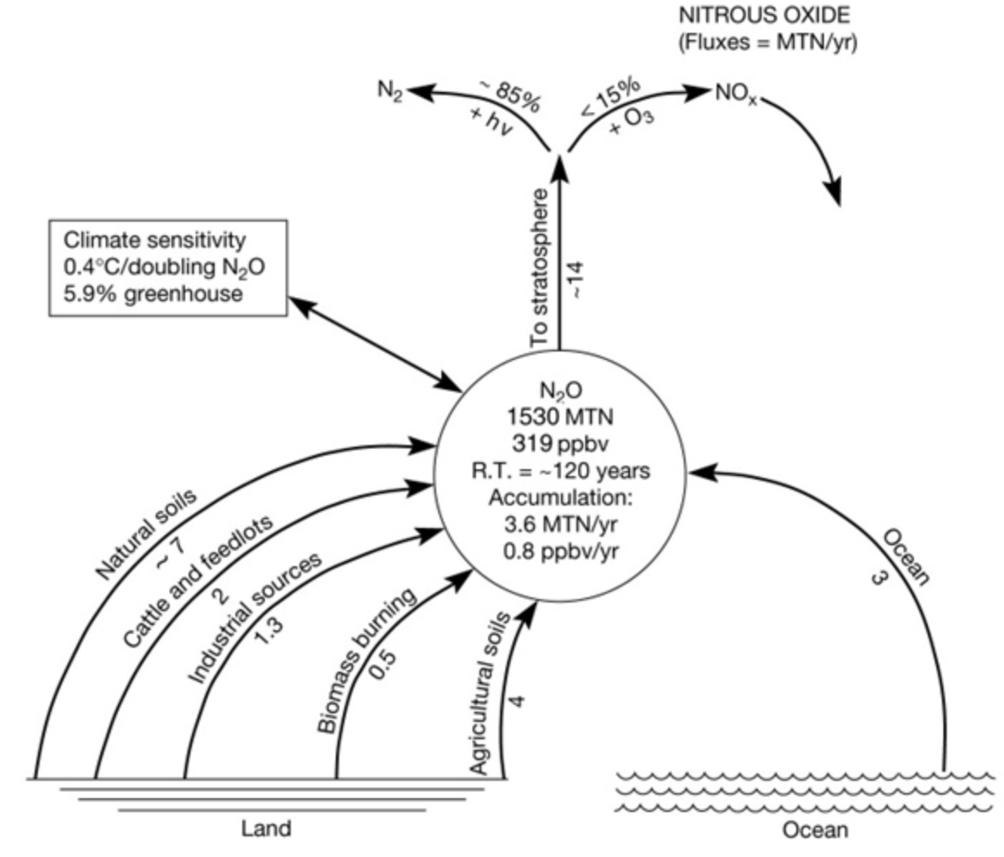
N2O
Anthropogenic activity accounts for around 30% of N2O, with tropical soils and oceanic release account for the majority of the remainder

Slide 32
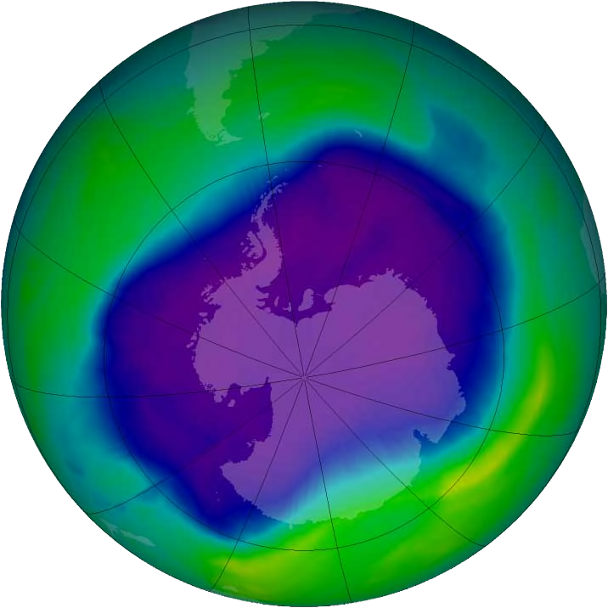
halocarbons
Refrigerants, aerosols …
Limited by “Montreal Protocol on substances that deplete the Ozone Layer”
Despite control, their continued presence in the atmosphere is of continuing concern for Ozone depletion as well as their role as GHGs.
Notes:
2006 Ozone hole
Signed 26 August 1987, it was made pursuant to the 1985 Vienna Convention for the Protection of the Ozone Layer, which established the framework for international cooperation in addressing ozone depletion.^{[1]} The Montreal Protocol entered into force on 26 August 1989, and has since undergone nine revisions, in 1990 (London), 1991 (Nairobi), 1992 (Copenhagen), 1993 (Bangkok), 1995 (Vienna), 1997 (Montreal), 1998 (Australia), 1999 (Beijing) and 2016 (Kigali).^{[2][3][4]}

Slide 33
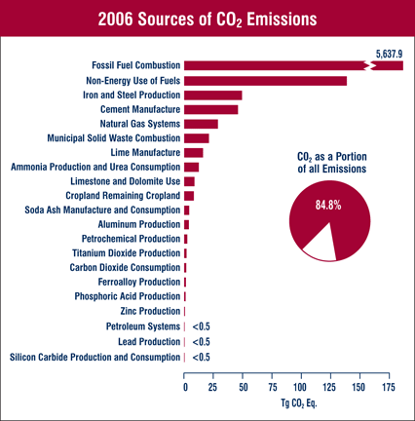
US emissions (2006)
Notes:
Fossil fuel bar far largest

Slide 34
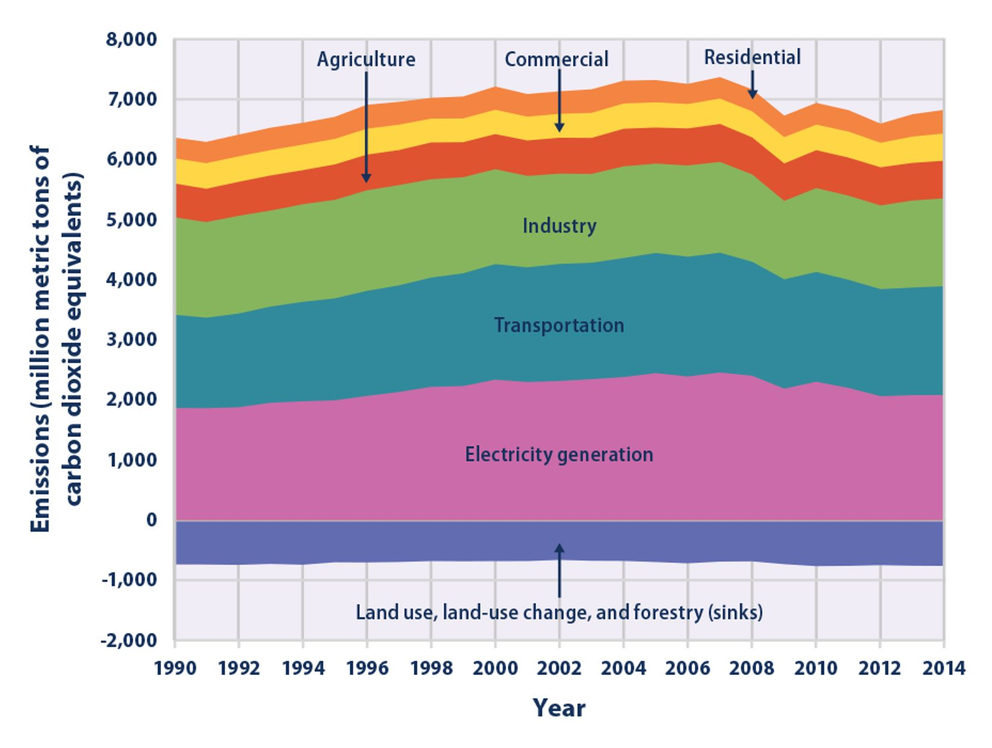

Slide 35
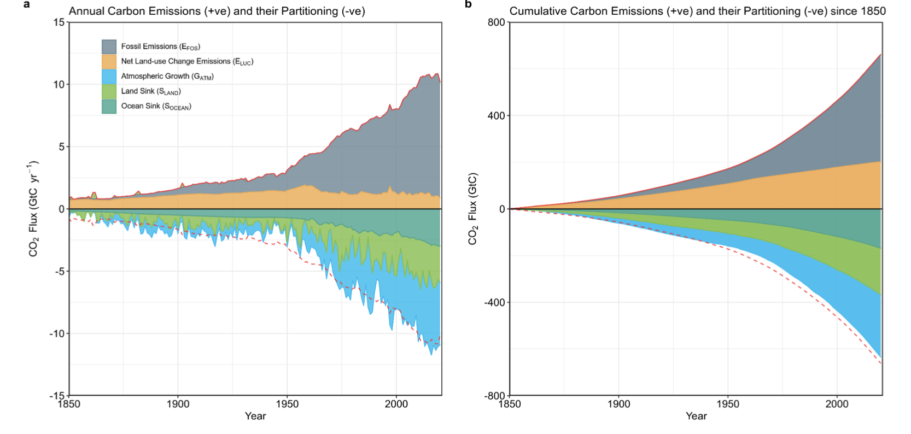
Global trends
Friedlingstein et al 2022
Notes:
https://essd.copernicus.org/preprints/essd-2021-386/essd-2021-386.pdf
Combined components of the global carbon budget illustrated in Fig. 2 as a function of
3 time, for fossil CO2 emissions (EFOS, including a small sink from cement carbonation; grey) and
4 emissions from land-use change (ELUC; brown), as well as their partitioning among the atmosphere
5 (GATM; cyan), ocean (SOCEAN; blue), and land (SLAND; green). Panel (a) shows annual estimates of
6 each flux and panel (b) the cumulative flux (the sum of all prior annual fluxes) since the year 1850.
7 The partitioning is based on nearly independent estimates from observations (for GATM) and from
8 process model ensembles constrained by data (for SOCEAN and SLAND) and does not exactly add up
9 to the sum of the emissions, resulting in a budget imbalance (BIM) which is represented by the
10 difference between the bottom red line (mirroring total emissions) and the sum of carbon fluxes
11 in the ocean, land, and atmosphere reservoirs. All data are in GtC yr-1 (panel a) and GtC (panel b).
12 The EFOS estimates are primarily from (Gilfillan and Marland, 2021), with uncertainty of about ±5%
13 (±1σ). The ELUC estimates are from three bookkeeping models (Table 4) with uncertainties of about
14 ±0.7 GtC yr-1. The GATM estimates prior to 1959 are from Joos and Spahni (2008) with uncertainties
15 equivalent to about ±0.1-0.15 GtC yr-1 and from Dlugokencky and Tans (2021) since 1959 with
16 uncertainties of about +-0.07 GtC yr-1 during 1959-1979 and ±0.02 GtC yr-1 since 1980. The SOCEAN
17 estimate is the average from Khatiwala et al. (2013) and DeVries (2014) with uncertainty of about
18 ±30% prior to 1959, and the average of an ensemble of models and an ensemble of fCO2 data
19 products (Table 4) with uncertainties of about ±0.4 GtC yr-1 since 1959. The SLAND estimate is the
20 average of an ensemble of models (Table 4) with uncertainties of about ±1 GtC yr-1. See the text
21 for more details of each component and their uncertainties.

Slide 36
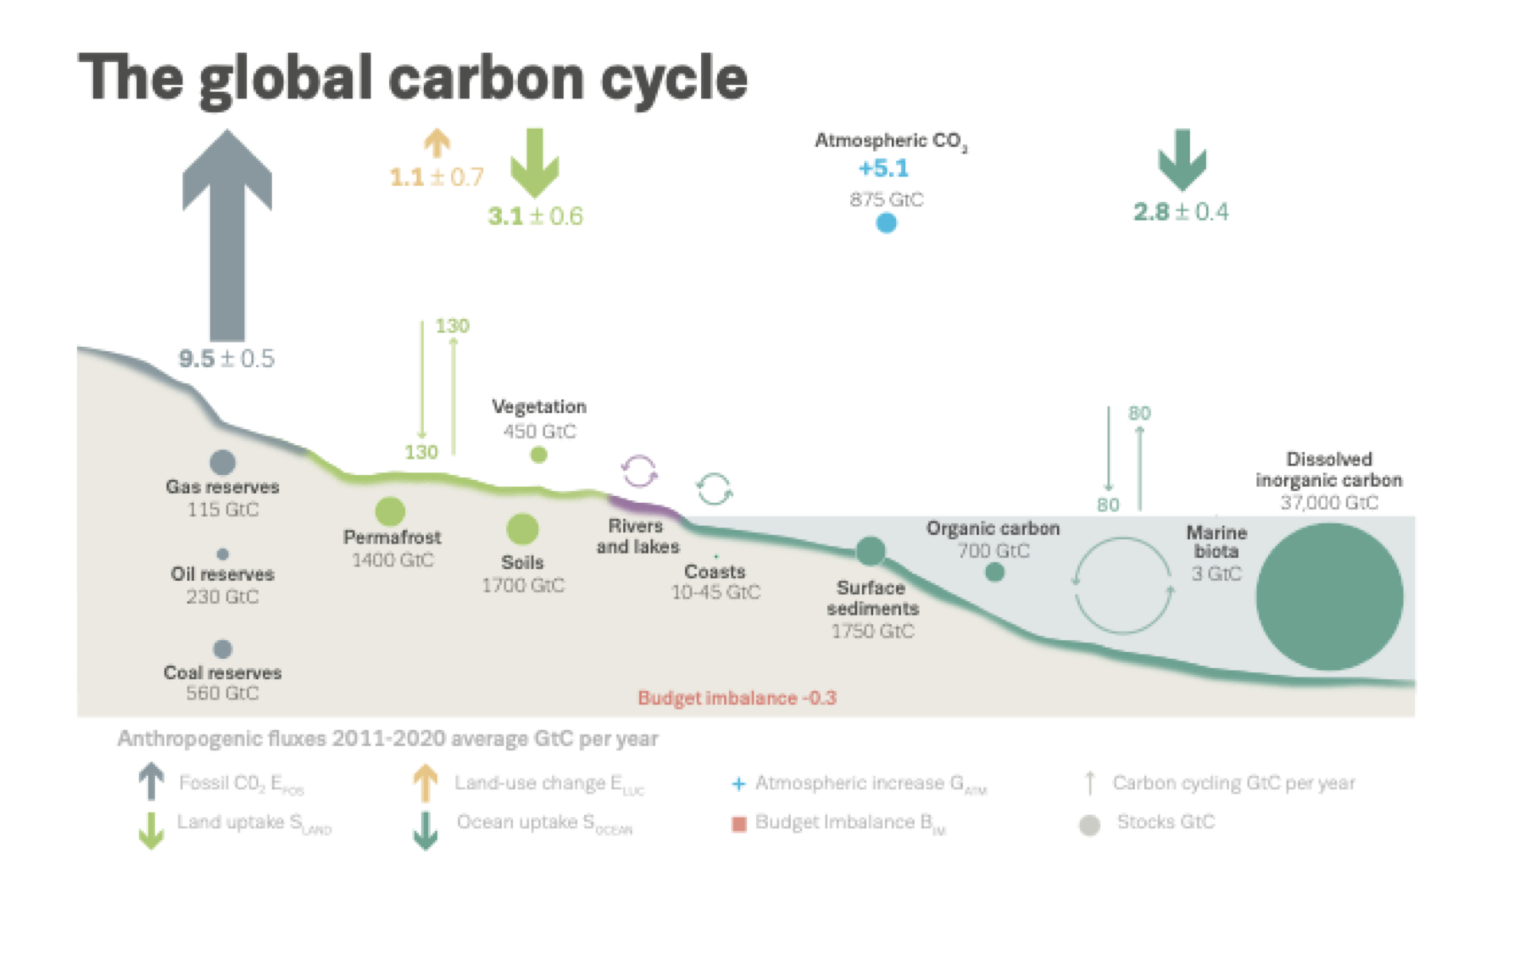
Global trends
Friedlingstein et al 2022
Notes:
More detail than previous slide on the fluxes, from AR5

Slide 37
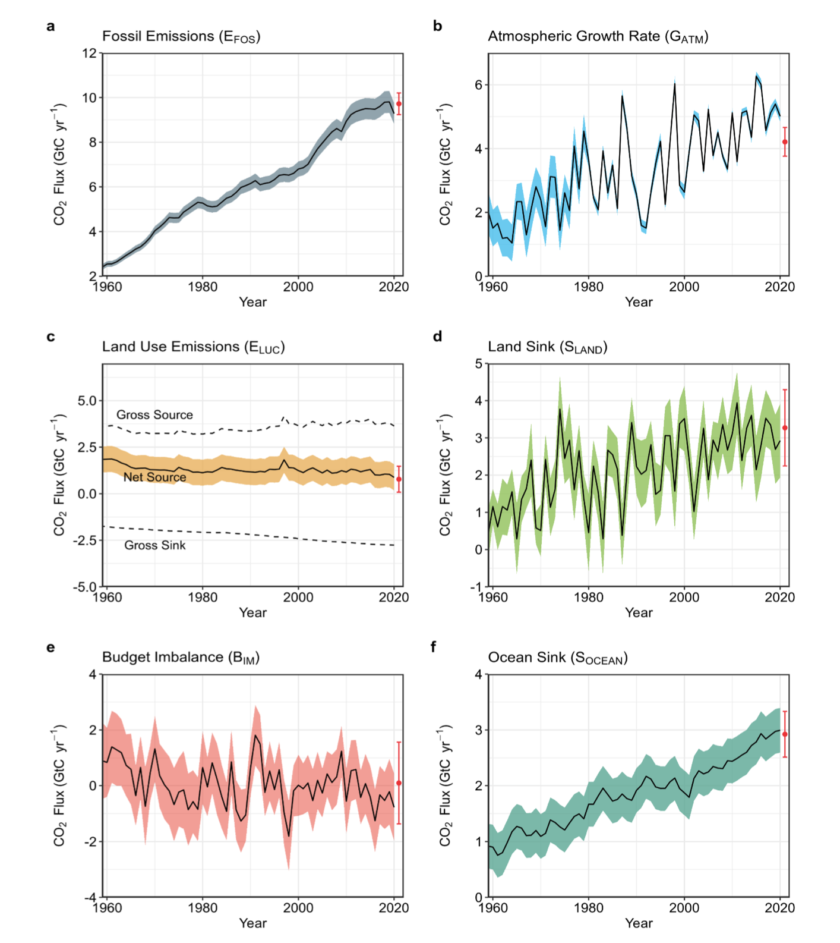
trends
Friedlingstein et al 2022

Slide 38
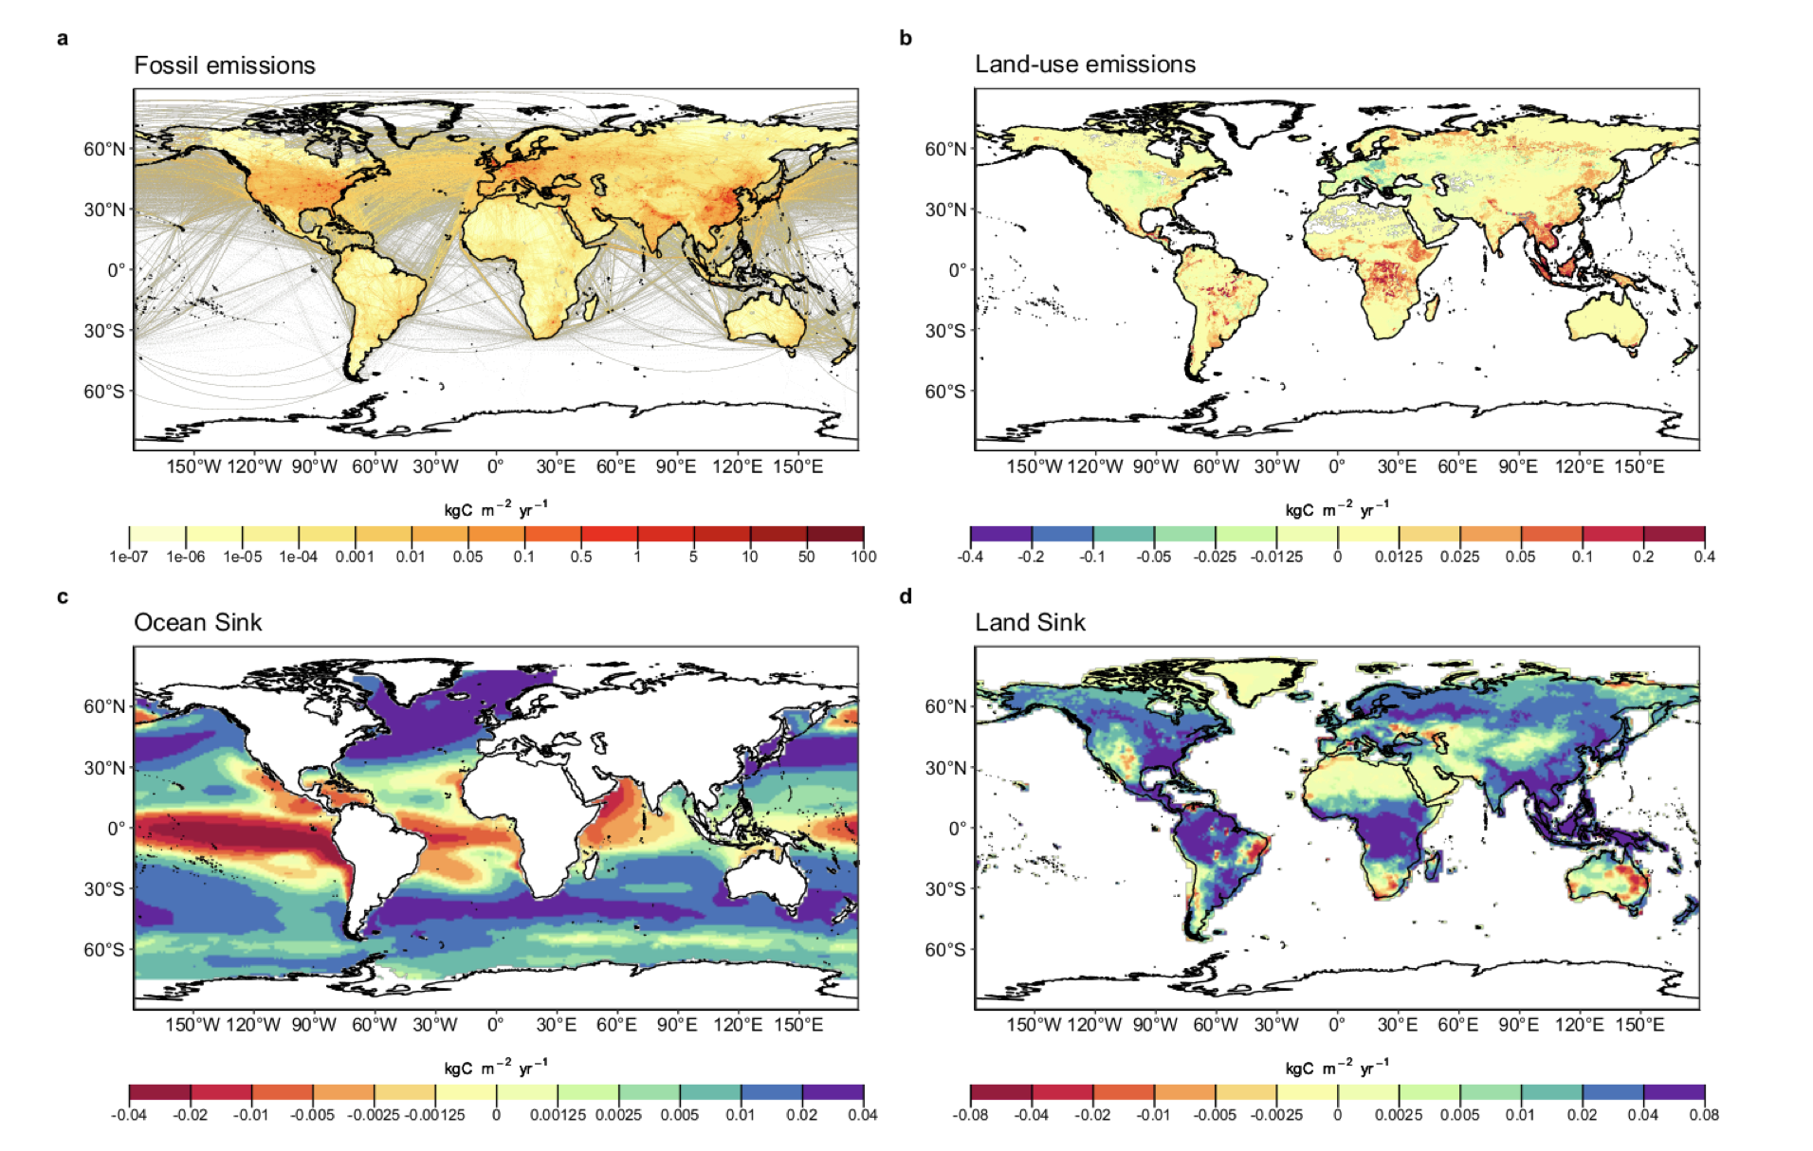
trends
2011-2020 decadal mean components
Friedlingstein et al 2021

Slide 39
summary
considered the importance of understanding the science of climate change
looked at basic principles of energy transfer in the earth system
concept and magnitudes of effective radiative forcing
examined greenhouse gases and their sources

Slide 40
Reading
https://interactive-atlas.ipcc.ch/
Radiative forcing https://www.nap.edu/download/11175
Global Carbon Budget 2022 https://essd.copernicus.org/articles/14/4811/2022/
https://www.carbonbrief.org/in-depth-qa-the-ipccs-sixth-assessment-report-on-climate-science
https://www.ipcc.ch/report/ar6/wg1/downloads/report/IPCC_AR6_WGI_TS.pdf
Rockstrom, Johan; Steffen, Will; Noone, Kevin; Persson, Asa; Chapin, F. Stuart; Lambin, Eric F.; et al., TM; Scheffer, M et al. (2009). “A safe operating space for humanity”. Nature 461 (7263): 472-475. doi:10.1038/461472a
FAO Global Forest Resource Assessment 2020
https://www.ipcc.ch/sr15/
IPCC Sixth Assessment Report: Climate Change: Working Group I: The Physical Science Basis and for a brief overview, the IPCC synthesis.

